Slide 1
Using ColdFusion ORM
Nick Kwiatkowski
Hawaii ColdFusion User’s Group
4/29/22

Slide 2
Agenda
What is an ORM system?
Pieces and Parts to using ORM in CFML
Basic CRUD operations
Building Relationships
HQL, grouping and computed rows
Optimizations, debugging and gotchas

Slide 3
Welcome!
Slides, examples and docker images can be found at :
https://github.com/quetwo/orm-preso
Take a look at the README for instructions on getting started. You have a few minutes while we talk about the basics.
This presentation assumes you have a passing knowledge of CFCs and basic CFML. We will be using the Lucee engine and MySQL for our demos, but Adobe CF (version 9.1 and later) and other SQL engines will be nearly identical.
This meeting will be recorded.

Slide 4
About Nick
CF programmer since the mid 90’s – started with CF 4.0.1
Member of the Apache Foundation, and a committer to a few projects
MMCFUG member and contributor
Adjunct Professor at Michigan State University in the College of Communication Arts and Sciences
Manager of the Unified Communications Team at Michigan State University

Slide 5
What is ORM

Slide 6
What is an ORM?
An ORM = Object Relation Manager
A system that manages the database layer within code.
Classes (or components in CF’s case) are directly translated to the database by an ORM. A database will have a table that represents a class in code. A row in the database represents an instance of the class.
1,000ft view – this means that each instance of this class is persisted not only in memory, but in a database. Data from the DB is also cached!
A quick benefit – you no longer need to write SQL. The ORM writes the SQL for you.
You no longer have to worry about SQL dialects – making your code much more portable across servers and platforms.

Slide 7
What is an ORM?
ORM technologies built on Java Hibernate have been built in to the CFML language since 2010.
Adobe ColdFusion 9 (really 9.0.2)
All versions of Lucee & Railo
No external frameworks or dependencies required to use.
There are 3rd party ORM systems available in CF as well.
ColdBox ORM
Mura / Masa CMS ORM

Slide 8
Basics of Scaffolding & Setup

Slide 9
Basics of Scaffolding
Scaffolding == Creating your DB layout via code.
You start with your CF Components and have CF create the database to match it.
All properties, indexing, etc. are all done for you. You won’t care about the back-end DB type
Setting up the CF ORM is done in the application.cfc
ormenabled property on the application.
ormsettings property for additional settings.
datasource property to define which datasource in CF/Lucee

Slide 10
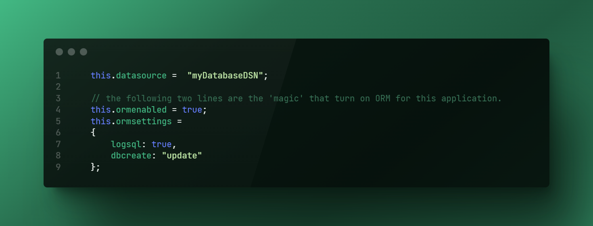
Basics of Scaffolding

Slide 11
Setup the Components
Once ORM is enabled in your application, you need to define some CFCs to take advantage of it.
New property on the CFC to tell the ORM engine that you want to ‘persist’ the component in the database.
Need to define the properties and give metadata as to what you plan on storing in them. These create automatic getter/setter functions for you.
Once you have these done, everything is wired up for you to write data to the database!

Slide 12
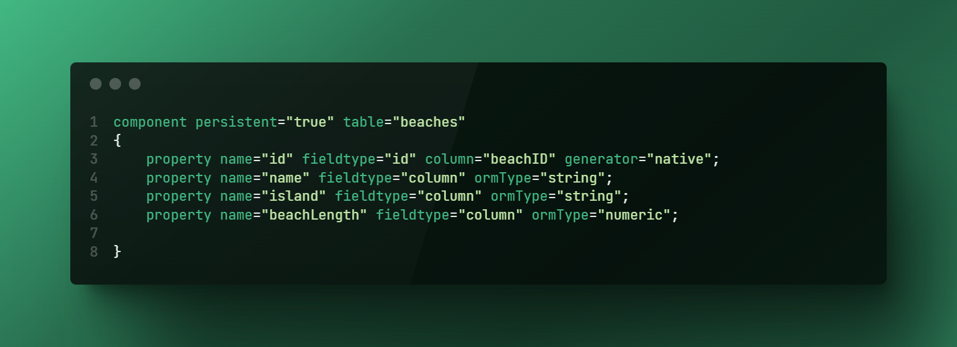
Setup the Components

Slide 13
Setup the Components
Your key field for the DB.
Field type of ‘id’. You will need to specify the ‘generator’
Most DBs you can use ‘native’. This will tell hibernate to pick the best way to setup a key field, based on the DB type.
Other generators also exist, including ones that will auto-increment, increment manually (usefully if you have other apps touching the data), create UUIDs, etc.
Regular Columns
Field type of ‘column’. Set the field-type as ‘column’ and set a ormType
ORMType can be ‘string’, ‘numeric’, ‘date’, ‘timestamp’, etc.
You can set other restrictions on the fields as well.

Slide 14
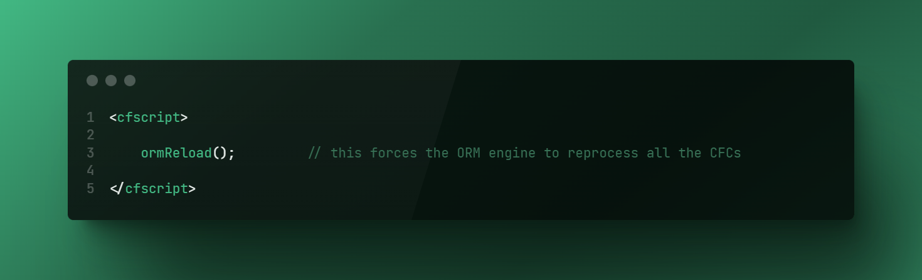
Setup the Components
Because CF caches the persistent component definitions when the application is initialized, you have two options to have your CFML engine see the changes:
Restart the CF Engine
Execute the ormReload() function.
The ormReload() function causes the Hibernate to be restarted, cache cleared and CFCs are reloaded. DB changes should be realized at this point.
Keep in mind, ormReload will clear out any unsaved data!

Slide 15
Demo 1
Setting up an ORM application

Slide 16
CRUD
Create, Read, Update, Delete

Slide 17
CRUD
Now we’ve determined that the table has been setup, let’s add a new entry into the table.
Remember, no SQL needed. Everything is done by touching the properties of the component.
entityNew = creates a new instance of the cfc in memory.
entitySave = tells the ORM to commit that data to the DB. If you don’t do this, it won’t get created.
Entities don’t get written to disk right away – they may be cached in memory for a while first! Issue an ormFlush() to save everything to disk right then.

Slide 18
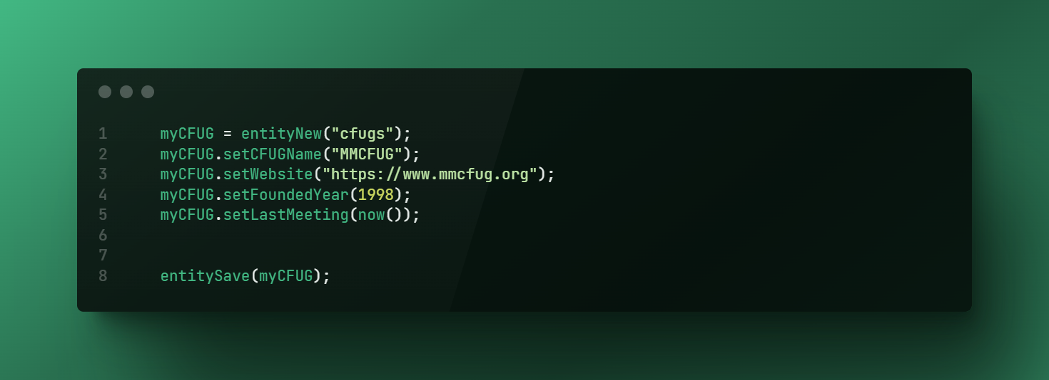
CRUD - Create

Slide 19
CRUD - Read
To get items out of the database, you will need to use one of the EntityLoad functions :
entityLoad(“componentName”); // returns an array of components
entityLoadByPK(“componentName”,id); // returns a single component
entityLoad(“componentName”, {filter}, unique); // returns an array, unless unique is set to true.
Unlike a <cfquery> command, you will get an Array back, not a query.
You can convert an array into a query if you need using the entityToQuery(entity) function.

Slide 20
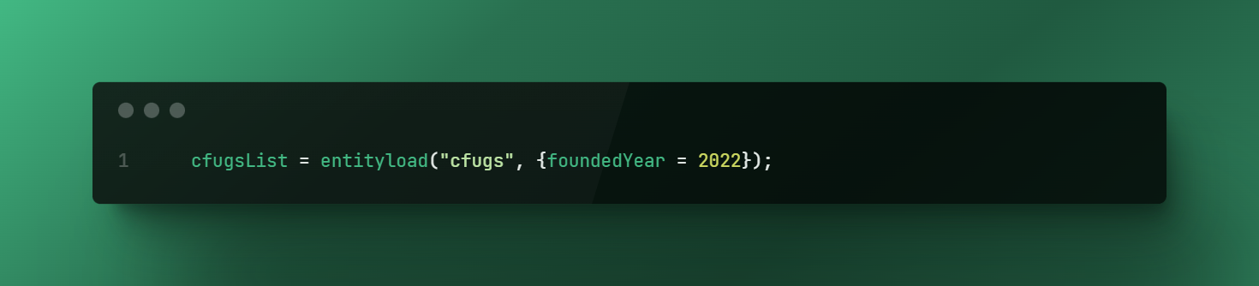
CRUD - Read
You can also filter (where clause) using the entityLoad() function.
The filter property takes an object as the filter.
You can filter on any property in the class (including computed properties)
In the entityLoad function, you can also ask to get a unique entity back.
This will give you a single entity instead of an array.

Slide 21
CRUD - Read
Once you have an entity / object back, you can use the “getter” methods to get to your data.
The returned data will be strongly typed, based on what came out of the DB (just like a query)
Automatically created methods for getters are just
Item.getProperty();

Slide 22
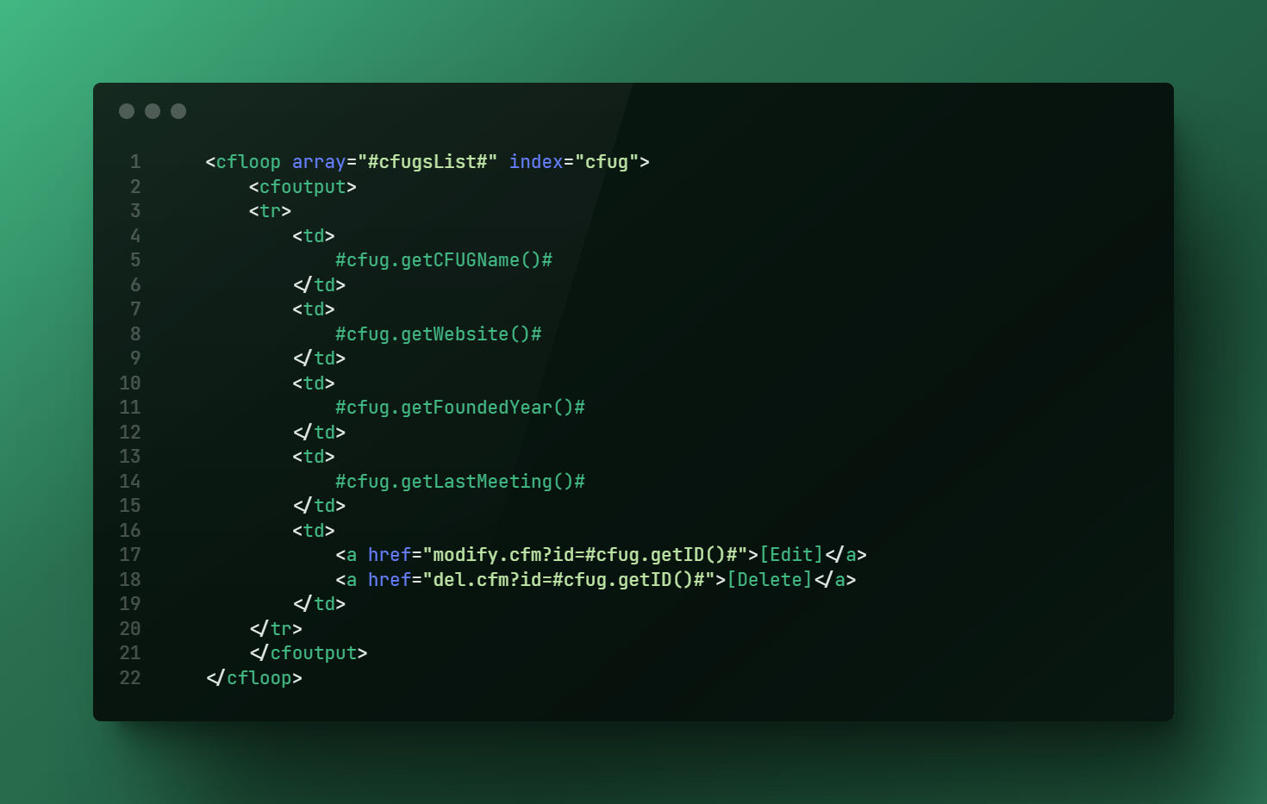
CRUD - Read

Slide 23
CRUD - Update
Updating an entity is just like creating new. All you would need to do is modify the entity in memory!
Item = entityLoadByPK(“component”,id);
Item.setProperty(“abc123”);
saveEntity(Item);

Slide 24

CRUD - Update

Slide 25
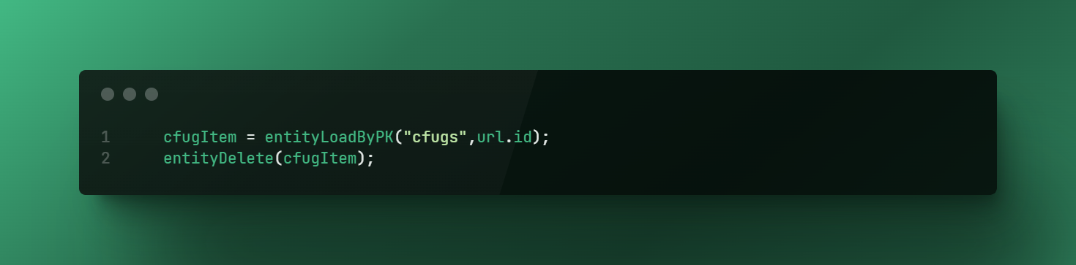
CRUD - Delete
Deleting an item is as simple as getting the item into memory and doing the entityDelete(item) function.
Item will be removed from cache immediately, and will be removed from the DB when it the transaction is flushed. Use the ormFlush() function to execute all updates/deletes immediately.

Slide 26
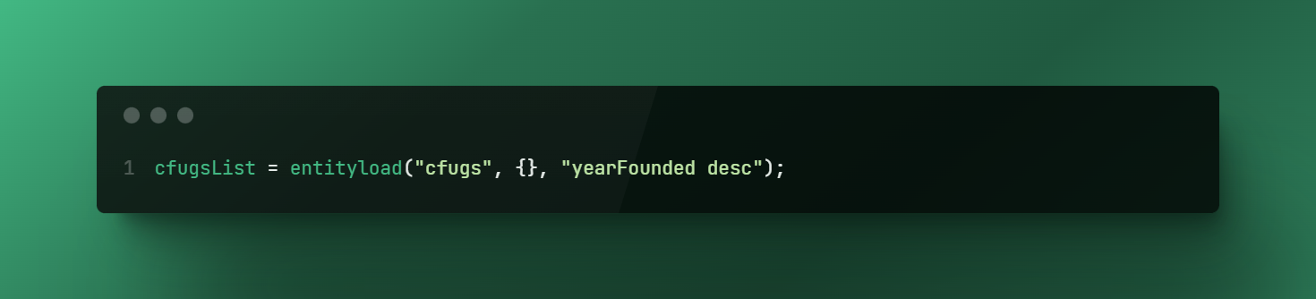
CRUD – Sorting
You can also have the data sorted for you as well (rather than DB/Cache order)
EntityLoad(“component”, {filter}, “sort statement”);
Sort statement would be just like SQL
“lastmeeting desc, foundedYear asc”

Slide 27
Demo 2 - CRUD

Slide 28
Relationships

Slide 29
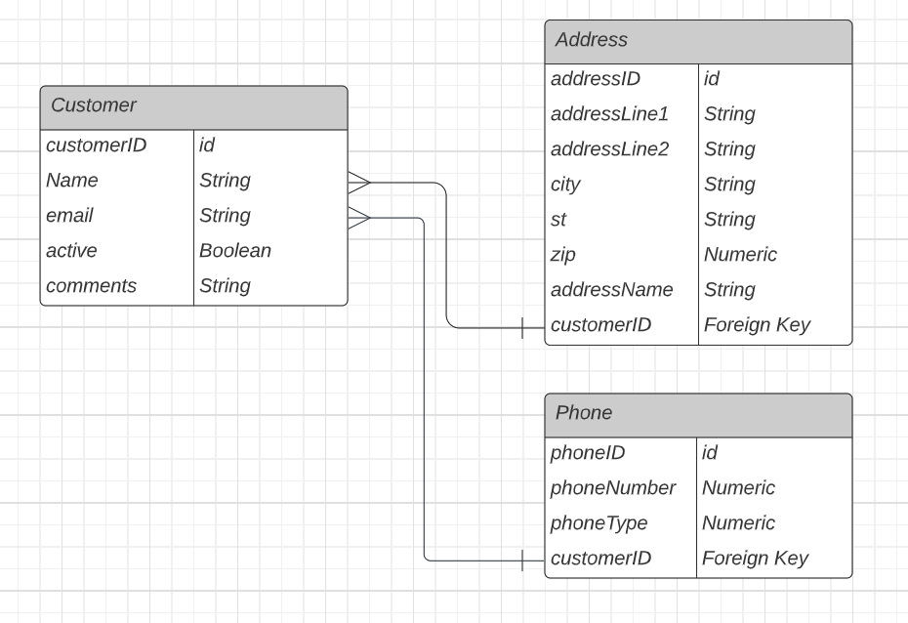
Relationships
For most normalized databases, you will have some sort of relationship between data sets.
Business -> Employee -> Address
Relationships are usually :
One to Many
Many to One
Many to Many
One to One

Slide 30
Relationships
We can define these relationships in our CFCs as well. This will tie tables together and allow you to use helper methods to get access to those linked components.
In the CFC, use the fieldType of “one-to-many”, “many-to-one”, “one-to-one” or “many-to-many” to define these relationships.
There are some additional properties you need for each one.

Slide 31
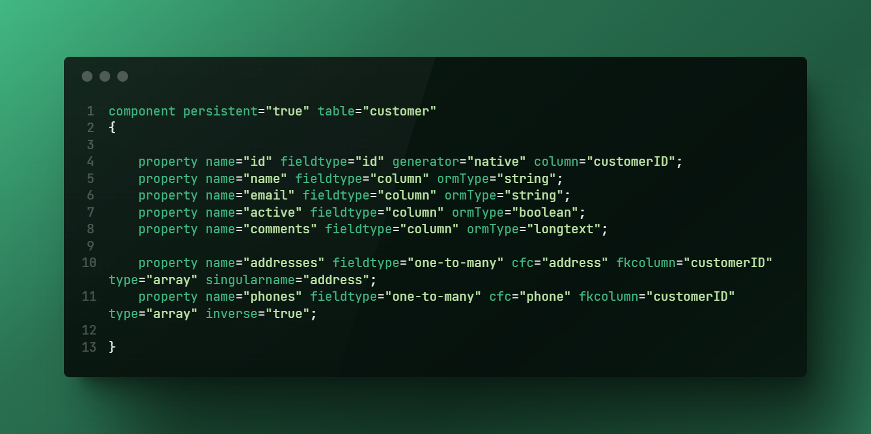
Relationships

Slide 32
Relationships – One to Many
This type of relationship is if you have one “parent” item that can reference multiple child items.
A single person can have multiple phone numbers.
When you specify a property as a one-to-many, you will also need the following properties:
cfc – specifies which component we are linking
fkcolumn – which column will be added to the linked component with the ID field of this component so the system can link these back.
type – How do you want the items back? Usually Array
singularname – Helper to fix up function names.

Slide 33
Relationships – One to Many
The following methods are auto-created to help with the related items.
component.addProperty(item); links the item to this component.
Item = component.getProperty(); returns the component
component.hasProperty(item); returns TRUE if item is linked
component.removeProperty(item); deletes the link to the component
Property above == the singular name set on the definition.

Slide 34
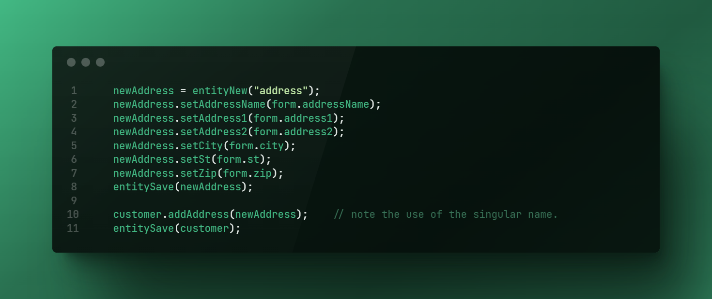
Relationships – One to Many

Slide 35
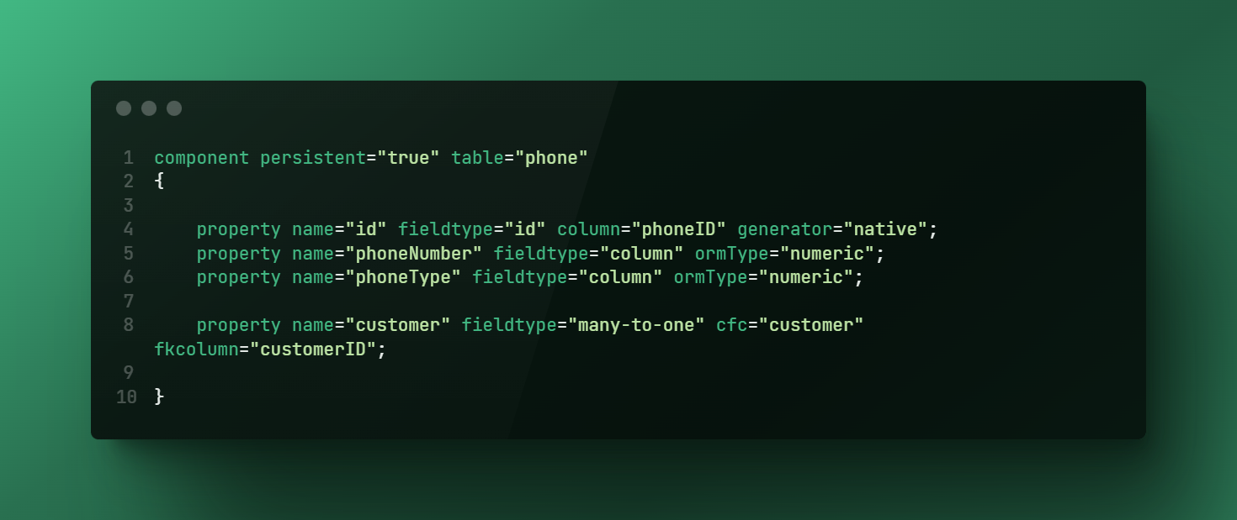
Relationships – Many to One
This would be the inverse of the one-to-many. This object can point to multiple children.
Similar properties as 1:many, BUT
fkcolumn which column in THIS component refers to the ID of the other component.
Type and singular name are not used.

Slide 36
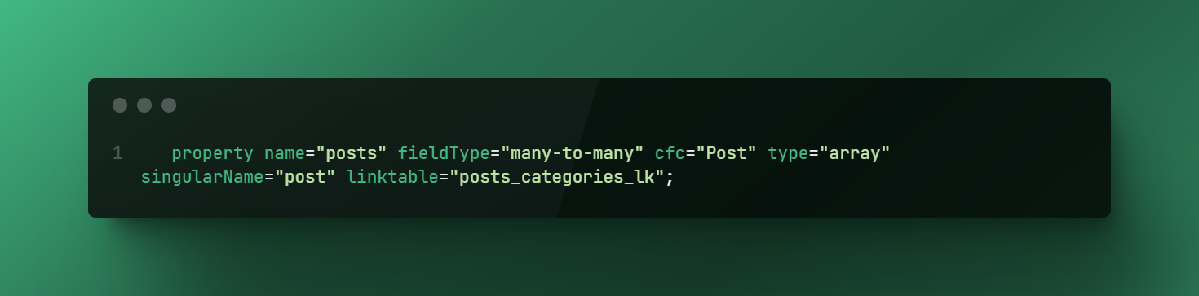
Relationships – Many to Many
This type of relationship is if you allow multiple items on each side. For example, a blog post could have many categories, and a category could have multiple blog posts.
Association is done via a link table.
Same properties as One to Many, but you also need to have a linktable property to define the name of the table to link. fkcolumn and inversejoincolumn allow you to name the fields in that table.

Slide 37
Relationships – One to One
This type of relationship is used to essentially ‘extend’ a table. For example, a single user can have a single Twitter profile.
The ‘primary’ component would have the fieldtype, cfc and fkcolumn properties, the ‘secondary’ component would have the fieldtype, cfc, and mappedBy properties.

Slide 38
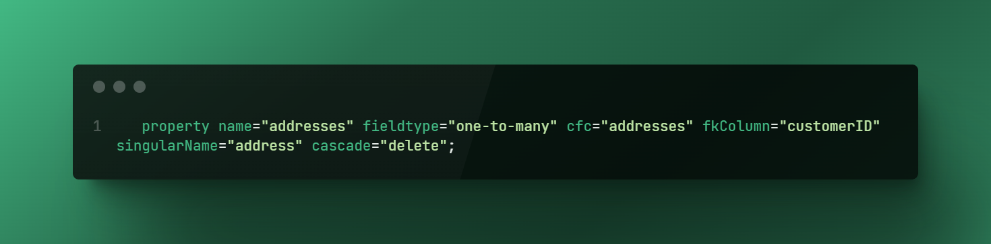
Cascading Relationships
You can also have the ORM clean up for you if you components!
For example, if you delete a customer record, it should delete all the customer’s addresses as well.

Slide 39
Demo 3 – Relationships

Slide 40
HQL

Slide 41
HQL
HQL – Hibernate Query Language is a language, similar to SQL that allows you to do queries on Hibernate objects.
The biggest difference with HQL is that you leave out ‘understood’ items. For example, if you want to do the equivalent of SELECT * FROM customers
The HQL would be FROM customers
It’s understood you always want to select all the properties, unless you override that behavior.

Slide 42
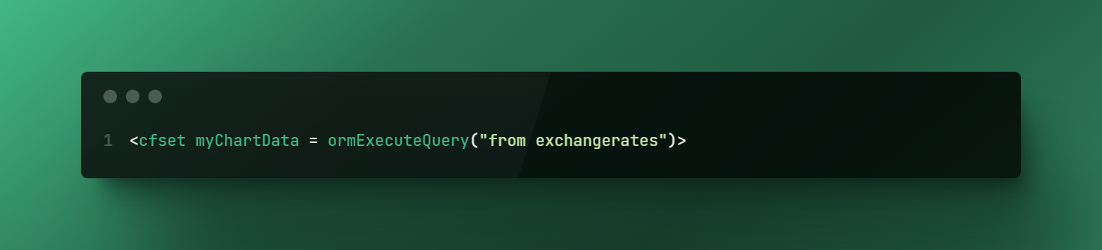
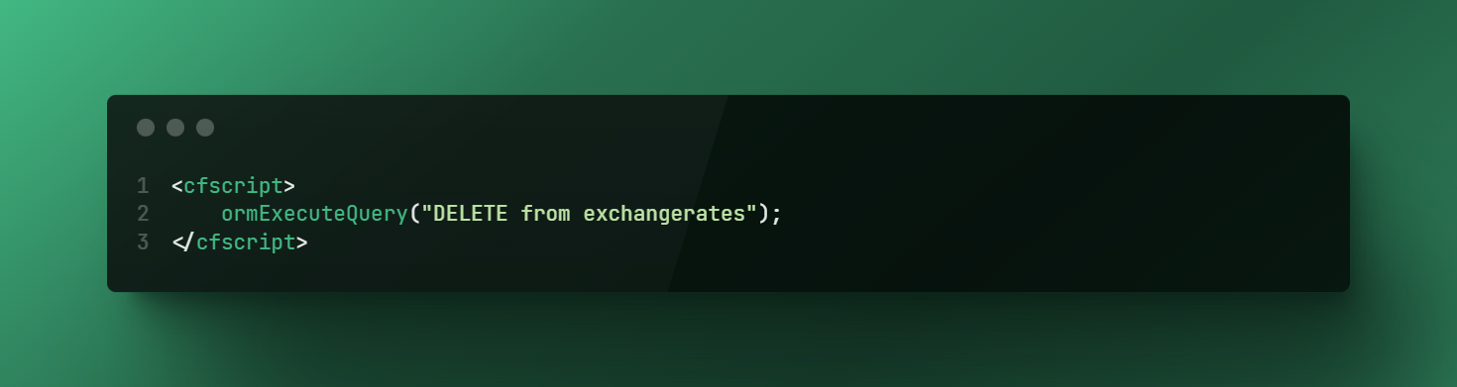
HQL
Executing HQL statements are done via the ormExecute() function. By default, you will get back an Array of components.

Slide 43
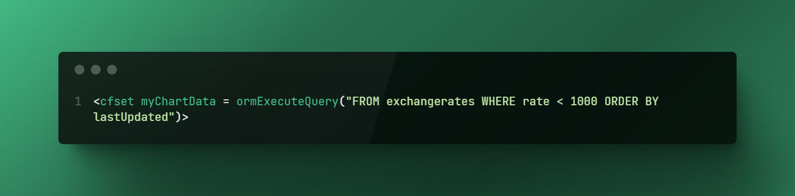
HQL
To order the items you get back, just like SQL, do an ORDER BY statement.
To filter items you get back, do a WHERE statement.

Slide 44
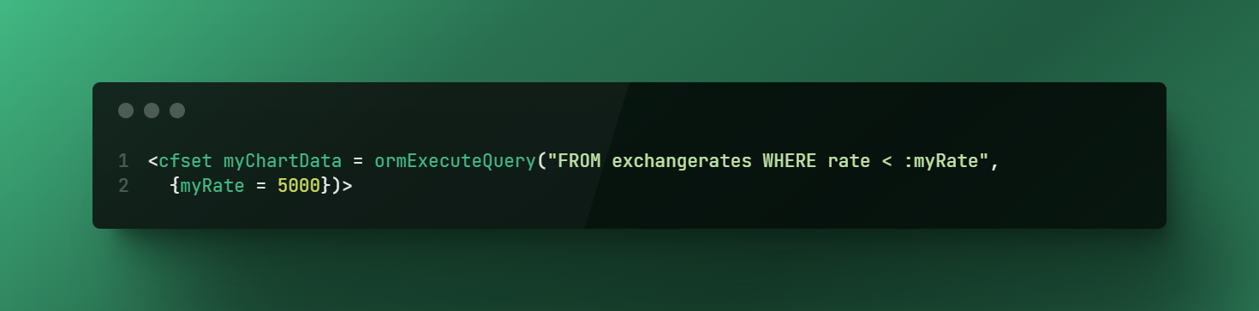
HQL
You can also do ‘named parameters’ just like in SQL. Think <cfqueryparam>
In the statement you would have a :property
After the statement, you would have an object that maps to that property.
You can also do ‘positional’ parameters by including a ? in the statement, then passing in an array of properties to include.

Slide 45
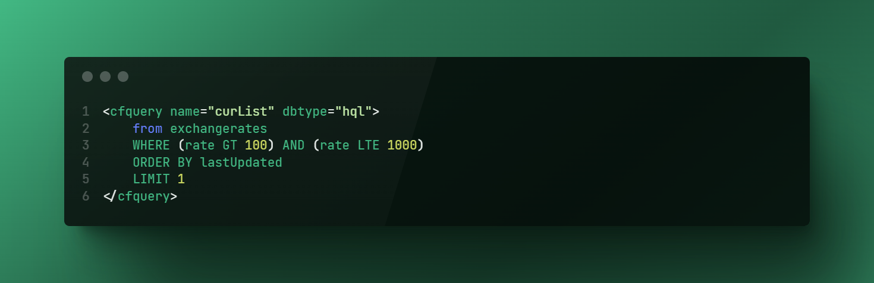
HQL
You can also use the awesome cfquery tags to do HQL commands!
Set the dbtype=“hql” on the cfquery tags and use cfquery on ORM objects!

Slide 46
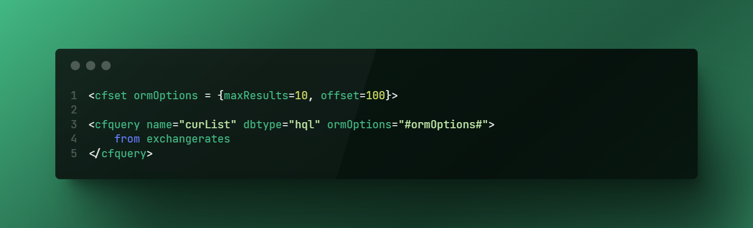
HQL Options
It also makes sense to do limits and offsets in HQL. For example, to do paging.
Data that is within cache will not hit the DB – but if you request a ton of data, the system will try to cache it!

Slide 47
Demo 4

Slide 48
Other Items

Slide 49
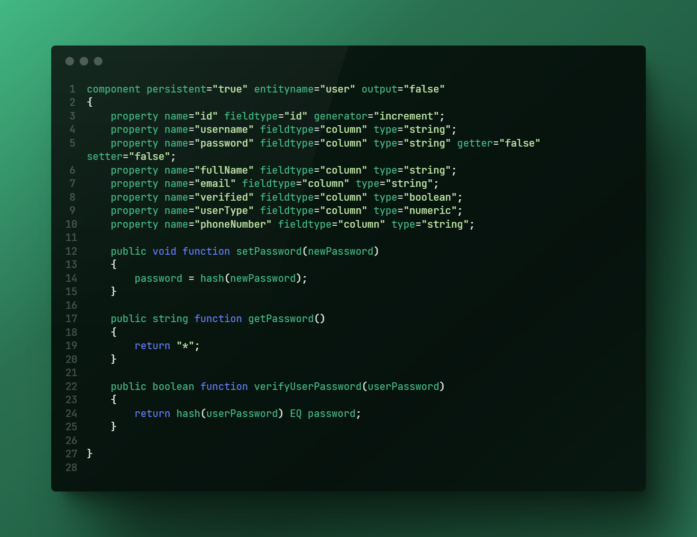
Other Items
Computed Entries
In addition to just laying out the properties, you can also have ‘computed’ entries in the CFC.
For example, if you don’t want to save the password of a user to the DB, you may want to store the encrypted version!

Slide 50
Other Items
Debugging
If you used the logSQL property on the ormSettings in the Application.cfc, all the SQL that is run against your DB is logged to the console.
Unfortunately, a long-standing bug in Lucee does not show this.
Quite common to dump objects using <cfdump> or writeDump() to the screen.
If you use <cfdump> make sure you set the top=2 or so – if you have linked components! Otherwise there may be a circular reference and you will run out of memory quick.
<cfdump var=“#itemList#” top=2>

Slide 51
Other Items
Get John Whish’s book!
https://www.coldfusionormbook.com/
THE resource for doing anything ORM in CF. Available as paperback or as a PDF.

Slide 52
Q&A

